Slide 1


Erfan Hosseinian Rad
June 22nd, 2025

Slide 2
Outline
Executive Summary
Introduction
Methodology
Results
Conclusion
Appendix

Slide 3
Executive Summary
The goal of this research is to analyze SpaceX Falcon 9 data collected through various sources and employ Machine Learning models to predict the success of first stage landing that provides other space agencies the ability to decide if they bid against SpaceX.
Summary of methodologies
Following concepts and methods were used to collect and analyze data, build and evaluate machine learning models, and make predictions:
Collect data through API and Web scraping
Transform data through data wrangling
Conduct exploratory data analysis with SQL and data visuals
Build an interactive map with folium to analyze launch site proximity
Build a dashboard to analyze launch records interactively with Plotly Dash
Finally, build a predictive model to predict if the first stage of Falcon 9 will land successfully
Summary of all results
This report will share results in various formats such as:
Data analysis results
Data visuals, interactive dashboards
Predictive model analysis results

Slide 4
Introduction
Project background and context
With the recent successes in private space travel, space industry is becoming more and more mainstream and accessible to general population. Cost of launch continues to remain a key barrier for new competitors to enter the space race
SpaceX with its first stage reuse capabilities offers a key advantage against its competitors. Each SpaceX launch costs around 62 million dollar and SpaceX can reuse stage 1 for future launches. This provides SpaceX a unique advantage where other competitors are spending around 165 mission plus for each launch
Problems you want to find answers
Determine if the first stage of SpaceX Falcon 9 will land successfully
Impact of different parameters/variables on the landing outcomes (e.g., launch site, payload mass, booster version, etc.)
Correlations between launch sites and success rates

Slide 5

5

Slide 6
Methodology
Executive Summary
Data collection methodology:
SpaceX API
Web scrap Falcon 9 and Falcon Heavy launch records from Wikipedia (link)
Perform data wrangling
Determined labels for training the supervised models by converting mission outcomes in to training labels (0-unsuccessful, 1-successful)
Perform exploratory data analysis (EDA) using visualization and SQL
Perform interactive visual analytics using Folium and Plotly Dash
Perform predictive analysis using classification models
Created a column for ‘class’; standardized and transformed data; train/test split data; find best classification algorithm (Logistic regression, SVM, decision tree, & KNN) using test data
6

Slide 7
Data Collection
Data collection is the process of gathering data from available sources. This data can be structured, unstructured, or semi-structured. For this project, data was collected via SpaceX API and Web scrapping Wiki pages for relevant launch data.
SpaceX API Web scraping data from Wiki
Read API response
Read .json response and convert to a Dataframe
Convert to CSV format
Convert new Dataframe to CSV format for the next phase
Create Beautiful Soap
Create beautiful soap object from HTML response
Convert to CSV format
Convert Dataframe to CSV for next phase
Request launch data from SpaceX API
Extract relevant data fields to match the requirements
Prelim data wrangling
Request Falcon9 html page via HTTP GET method
Collect all relevant headers/extract rows to Datafame
API request
Perform HTTP GET
Extract data to DF
7

Slide 8
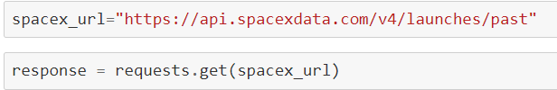


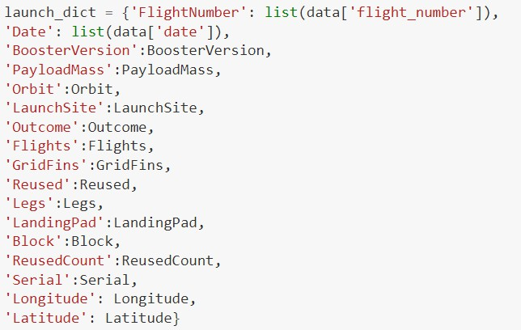
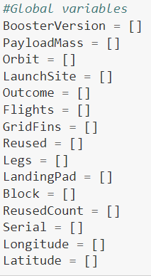
Data Collection – SpaceX API
1. API Request and read response into DF
2. Declare global variables
3. Call helper functions with API calls to populate global vars
4. Construct data using dictionary
5. Convert Dict to Dataframe, filter for Falcon9 launches, covert to CSV
1. Create API GET request, normalize data and read in to a Dataframe:
Call helper functions to get relevant data where columns have IDs (e.g., rocket column is an identification number)
getBoosterVersion(data)
getLaunchSite(data)
getPayloadData(data)
getCoreData(data)
4. Create Dataframe from dictionary and filter to keep only the Falcon9 launches:
• c
4. Construct dataset from received data & combine columns into a dictionary:
2. Declare global variable lists that will store data returned by helper functions with additional API calls to get relevant data
GitHub

Slide 9
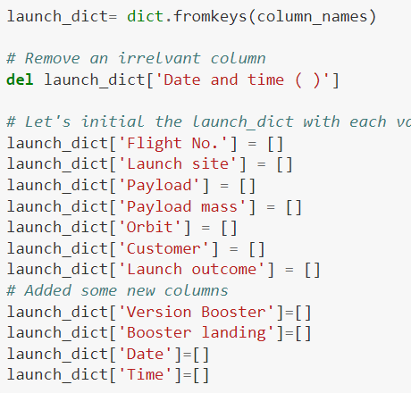



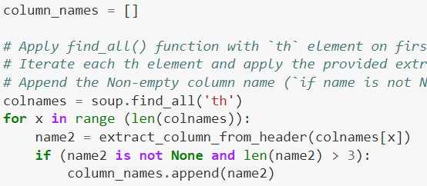
Data Collection - Scraping
1. Perform HTTP GET to request HTML page
2. Create Beautiful Soap object
3. Extract column names from HTML table header
4. Create Dictionary with keys from extracted column
names
5. Call helper functions to fill up dict with launch records
6. Convert Dictionary to Dataframe
1. Create API GET method to request Falcon9 launch HTML page
4. Create an empty Dictionary with keys from extracted column names:
Fill up the launch_dict with launch records extracted from table rows.
Utilize following helper functions to help parse HTML data
• c
2. Create Beautiful Soap object
3. Find all the tables on the Wiki page and extract relevant column names from the HTML table header
6. Convert launch_dict to Dataframe:
GitHub

Slide 10
Data Wrangling
Conducted Exploratory Data Analysis (EDA) to find patters in data and define
labels for training supervised models
The data set contained various mission outcomes that were converted into Training Labels with 1 meaning the booster successfully landed and 0 meaning booster was unsuccessful in landing. Following landing scenarios were considered to create labels:
True Ocean means the mission outcome was successfully landed to a specific region of the ocean
False Ocean means the mission outcome was unsuccessfully landed to a specific
region of the ocean
RTLS means the mission outcome was successfully landed to a ground pad
False RTLS means the mission outcome was unsuccessfully landed to a ground pad
True ASDS means the mission outcome was successfully landed on a drone ship
False ASDS means the mission outcome was unsuccessfully landed on a drone ship
GitHub

Slide 11
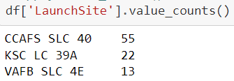
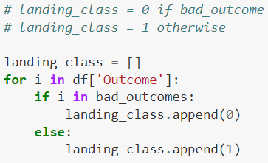
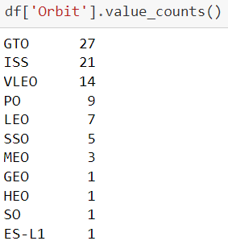

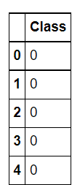
Data Wrangling – cont’d
1. Load dataset in to Dataframe
2. Find patterns in data
3. Create landing outcome label
1. Load SpaceX dataset (csv) in to a Dataframe
Find data patterns:
Calculate the number of launches on each site
Calculate the number and occurrence of each orbit
Calculate number/occurrence of mission outcomes per orbit type
3. Create a landing outcome label from Outcome column in the Dataframe
GitHub
11

Slide 12
EDA with Data Visualization
As part of the Exploratory Data Analysis (EDA), following charts were plotted to gain further insights into the dataset:
Scatter plot:
Shows relationship or correlation between two variables making patterns easy to observe
Plotted following charts to visualize:
Relationship between Flight Number and Launch Site
Relationship between Payload and Launch Site
Relationship between Flight Number and Orbit Type
Relationship between Payload and Orbit Type
Bar Chart:
Commonly used to compare the values of a variable at a given point in time. Bar charts makes it easy to see which groups are highest/common and how other groups compare against each other. Length of each bar is proportional to the value of the items that it represents
Plotted following Bar chart to visualize:
Relationship between success rate of each orbit type
Line Chart:
Commonly used to track changes over a period of time. It helps depict trends over time.
Plotted following Line chart to observe:
Average launch success yearly trend
GitHub
12

Slide 13
EDA with SQL
To better understand SpaceX data set, following SQL queries/operations were
performed on an IBM DB2 cloud instance:
Display the names of the unique launch sites in the space mission
Display 5 records where launch sites begin with the string 'CCA’
Display the total payload mass carried by boosters launched by NASA (CRS)
Display average payload mass carried by booster version F9 v1.1
List the date when the first successful landing outcome in ground pad was achieved.
List the names of the boosters which have success in drone ship and have payload mass greater than 4000 but less than 6000
List the total number of successful and failure mission outcomes
List the names of the booster_versions which have carried the maximum payload mass. Use a subquery
List the failed landing_outcomes in drone ship, their booster versions, and launch site names for in year 2015
Rank the count of landing outcomes (such as Failure (drone ship) or Success (ground pad))
between the date 2010-06-04 and 2017-03-20, in descending order
GitHub 13

Slide 14
Build an Interactive Map with Folium
Folium interactive map helps analyze geospatial data to perform more interactive visual analytics and better understand factors such location and proximity of launch sites that impact launch success rate.
Following map object were created and added to the map:
Mark all launch sites on the map. This allowed to visually see the launch sites on the map.
Added ‘folium.circle’ and ‘folium.marker’ to highlight circle area with a text label over each launch site.
Added a ‘MarkerCluster()’ to show launch success (green) and failure (red) markers for each launch site.
Calculated distances between a launch site to its proximities (e.g., coastline, railroad, highway, city)
Added ‘MousePosition() to get coordinate for a mouse position over a point on the map
Added ‘folium.Marker()’ to display distance (in KM) on the point on the map (e.g., coastline, railroad, highway, city)
Added ‘folium.Polyline()’ to draw a line between the point on the map and the launch site
Repeated steps above to add markers and draw lines between launch sites and proximities – coastline, railroad, highway, city)
Building the Interactive Map with Folium helped answered following questions:
Are launch sites in close proximity to railways? YES
Are launch sites in close proximity to highways? YES
Are launch sites in close proximity to coastline? YES
Do launch sites keep certain distance away from cities? YES
GitHub

Slide 15
Build a Dashboard with Plotly Dash
Built a Plotly Dash web application to perform interactive visual analytics on SpaceX launch data in real-time. Added Launch Site Drop-down, Pie Chart, Payload range slide, and a Scatter chart to the Dashboard.
Added a Launch Site Drop-down Input component to the dashboard to provide an ability to filter Dashboard visual by all launch sites or a particular launch site
Added a Pie Chart to the Dashboard to show total success launches when ‘All Sites’ is selected and
show success and failed counts when a particular site is selected
Added a Payload range slider to the Dashboard to easily select different payload ranges to identify visual patterns
Added a Scatter chart to observe how payload may be correlated with mission outcomes for selected site(s). The color-label Booster version on each scatter point provided missions outcomes with different boosters
Dashboard helped answer following questions:
Which site has the largest successful launches? KSC LC-39A with 10
Which site has the highest launch success rate? KSC LC-39A with 76.9% success
Which payload range(s) has the highest launch success rate? 2000 – 5000 kg
Which payload range(s) has the lowest launch success rate? 0-2000 and 5500 - 7000
Which F9 Booster version (v1.0, v1.1, FT, B4, B5, etc.) has the highest launch success rate? FT
GitHub

Slide 16
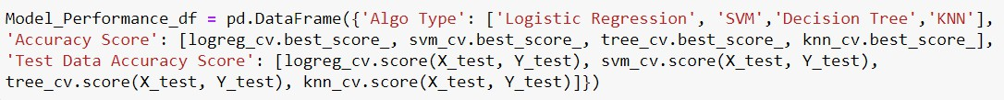

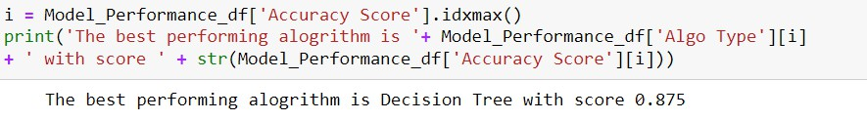
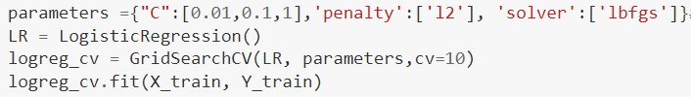
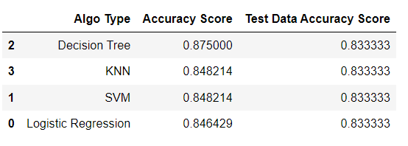
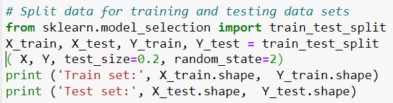

Predictive Analysis (Classification)
1. Read dataset into Dataframe
and create a ‘Class’ array
2. Standardize the data
3. Train/Test/Split data in to
training and test data sets
4. Create and Refine Models
5. Find the best performing
Model
1. Load SpaceX dataset (csv) in to a Dataframe and create NumPy array from the column class in data
Create and refine Models based on following classification Algorithms: (below is LR example)
Create Logistic Regression object and then
create a GridSearchCV object
Fit train data set in to the GridSearchCV object and train the Model
Find and display best hyperparameters and accuracy score
Check the accuracy on the test data by creating a confusion matrix
Repeat above steps for Decision Tree, KNN, and SVM algorithms
3. Find the best performing model
2. Standardize data in X then reassign to variable X using transform
3. Train/test/split X and Y in to training and test data sets.
GitHub

Slide 17
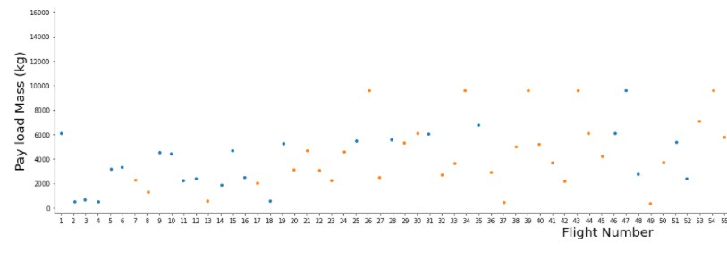
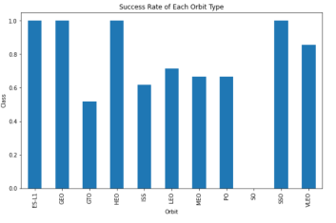
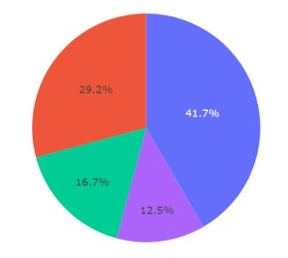
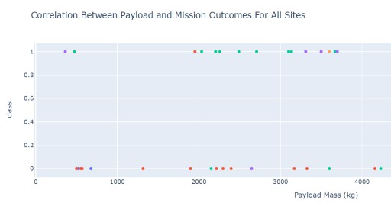
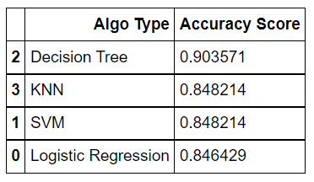
Results
Following sections and slides explain results for:
Samples:
Exploratory data
analysis results
Samples
Interactive analytics demo in screenshots
Samples
Predictive analysis
results
17

Slide 18


Slide 19
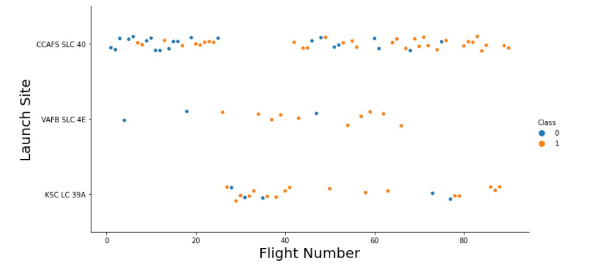
Flight Number vs. Launch Site
Success rates (Class=1) increases as the number of flights increase
For launch site ‘KSC LC 39A’, it takes at least around 25 launches before a first
successful launch

Slide 20
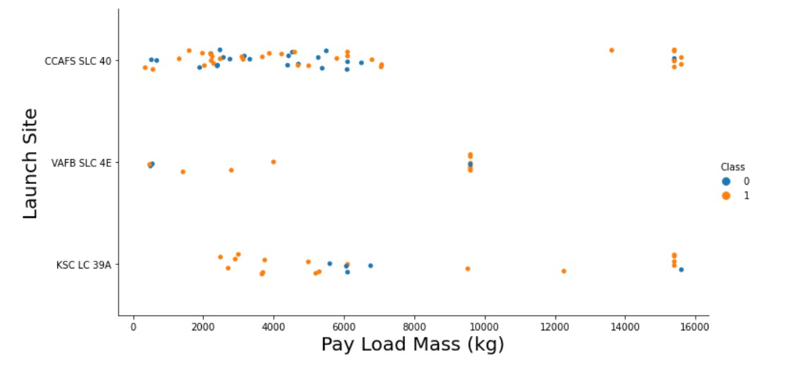
Payload vs. Launch Site
For launch site ‘VAFB SLC 4E’, there are no rockets launched for payload
greater than 10,000 kg
Percentage of successful launch (Class=1) increases for launch site ‘VAFB SLC 4E’ as the payload mass increases
There is no clear correlation or pattern between launch site and payload
mass

Slide 21
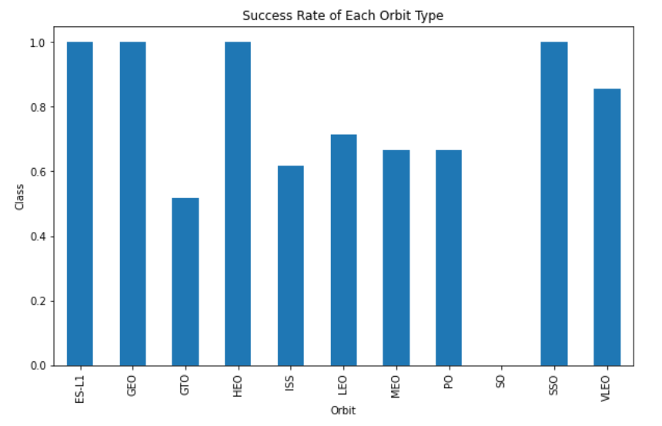
Success Rate vs. Orbit Type
Orbits ES-LI, GEO, HEO, and SSO have the highest success rates
GTO orbit has the lowest success rate

Slide 22
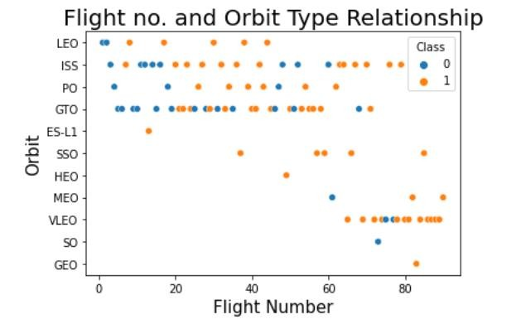
Flight Number vs. Orbit Type
For orbit VLEO, first successful landing (class=1) doesn’t occur until 60+
number of flights
For most orbits (LEO, ISS, PO, SSO, MEO, VLEO) successful landing rates appear to increase with flight numbers
There is no relationship between flight number and orbit for GTO
22

Slide 23
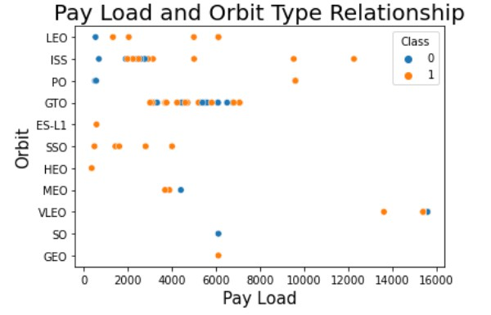
Payload vs. Orbit Type
Successful landing rates (Class=1) appear to increase with pay load for
orbits LEO, ISS, PO, and SSO
For GEO orbit, there is not clear pattern between payload and orbit for successful or unsuccessful landing
23

Slide 24
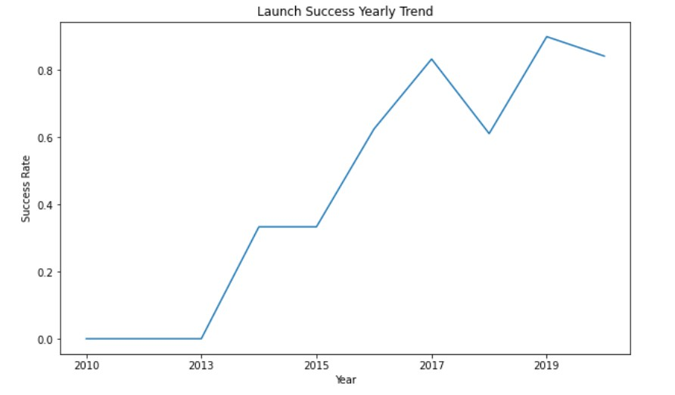
Launch Success Yearly Trend
Success rate (Class=1) increased by about 80% between 2013 and 2020
Success rates remained the same between 2010 and 2013 and between 2014
and 2015
Success rates decreased between 2017 and 2018 and between 2019 and 2020
24

Slide 25
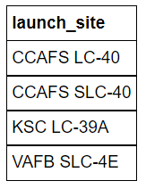
All Launch Site Names
Query:
Description:
‘distinct’ returns only unique values from the queries column (Launch_Site)
There are 4 unique launch sites
Result:

Slide 26
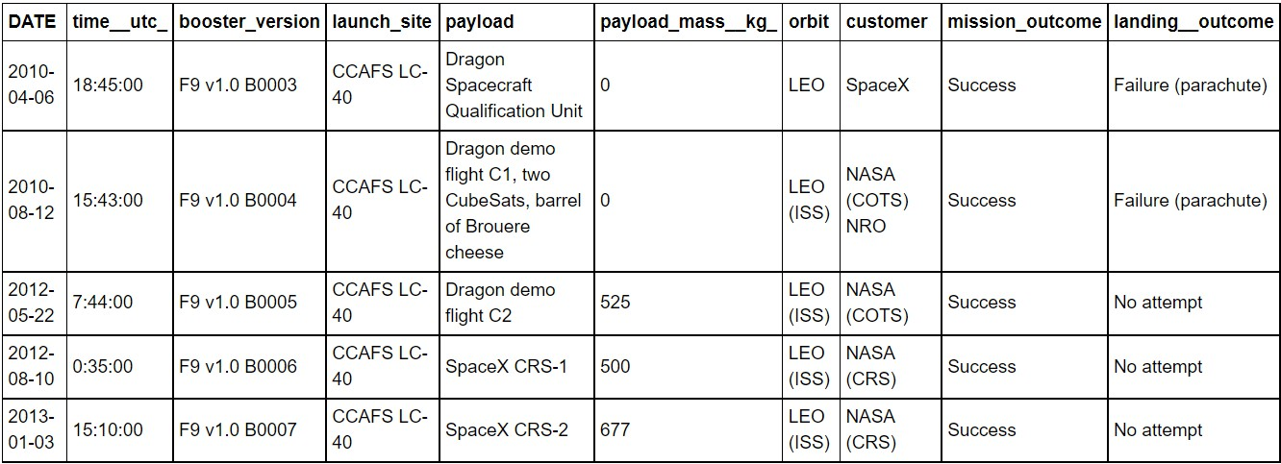
Launch Site Names Begin with 'CCA'
Query:
Description:
Using keyword ‘Like’ and format ‘CCA%’, returns records where ‘Launch_Site’ column
starts with “CCA”.
Limit 5, limits the number of returned records to 5
Result:

Slide 27

Total Payload Mass
Query:
Description:
‘sum’ adds column ‘PAYLOAD_MASS_KG’ and returns total payload mass for customers named ‘NASA (CRS)’
Result:

Slide 28

Average Payload Mass by F9 v1.1
Query:
Description:
‘avg’ keyword returns the average of payload mass in ‘PAYLOAD_MASS_KG’ column where booster version is ‘F9 v1.1’
Result:

Slide 29

First Successful Ground Landing Date
Query:
Description:
‘min(Date)’ selects the first or the oldest date from the ‘Date’ column where first successful
landing on group pad was achieved
Where clause defines the criteria to return date for scenarios where ‘Landing_Outcome’ value is equal to ‘Success (ground pad)’
Result:

Slide 30
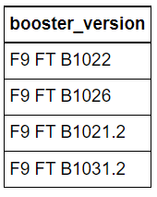
Successful Drone Ship Landing with Payload between 4000 and 6000
Query:
Description:
The query finds the booster version where payload mass is greater than 4000 but less than 6000 and the landing outcome is success in drone ship
The ‘and’ operator in the where clause returns booster versions where both conditions in the where clause are true
Result:

Slide 31
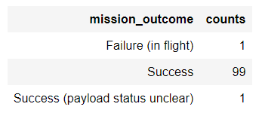
Total Number of Successful and Failure Mission Outcomes
Query:
Description:
The ‘group by’ keyword arranges identical data in a column in to group
In this case, number of mission outcomes by types of outcomes are grouped in column
‘counts’
Result:

Slide 32
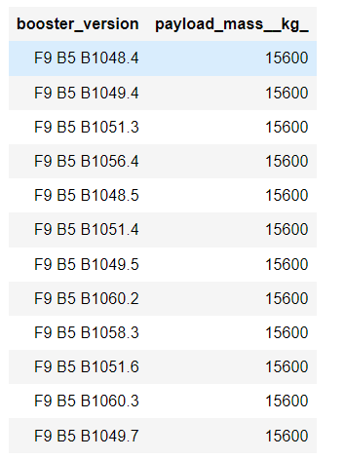
Boosters Carried Maximum Payload
Query:
Description:
The sub query returns the maximum payload mass by using keywork ‘max’ on the pay load
mass column
The main query returns booster versions and respective payload mass where payload mass is maximum with value of 15600
Result:

Slide 33

2015 Launch Records
Query:
Description:
The query lists landing outcome, booster version, and the launch site where landing outcome is failed in drone ship and the year is 2015
The ‘and’ operator in the where clause returns booster versions where both conditions in the where clause are true
The ‘year’ keywork extracts the year from column ‘Date
The results identify launch site as ‘CCAFS LC-40’ and booster version as F9 v1.1 B1012 and
B1015 that had failed landing outcomes in drop ship in the year 2015
Result:

Slide 34
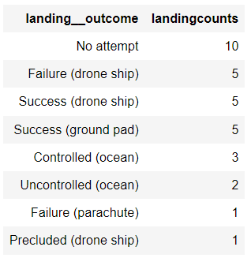
Rank Landing Outcomes Between 2010-06-04 and 2017-03-20
Query:
Description:
The ‘group by’ key word arranges data in column ‘Landing Outcome’ into groups
The ‘between’ and ‘and’ keywords return data that is between 2010-06-04 and 2017-03-20
The ‘order by’ keyword arranges the counts column in descending order
The result of the query is a ranked list of landing outcome counts per the specified date range
Result:

Slide 35


Slide 36
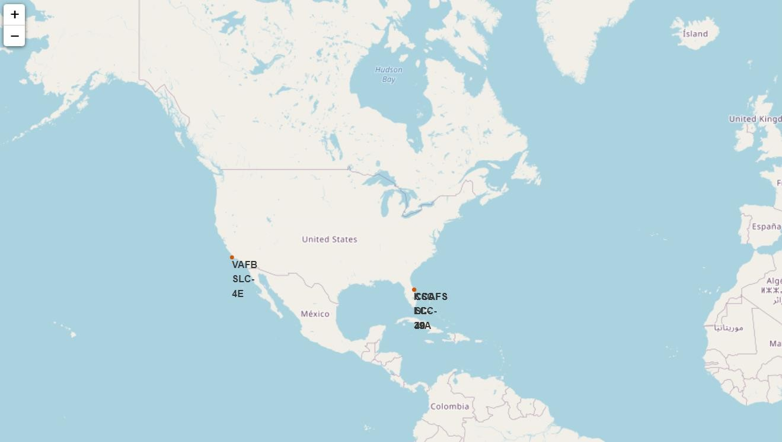
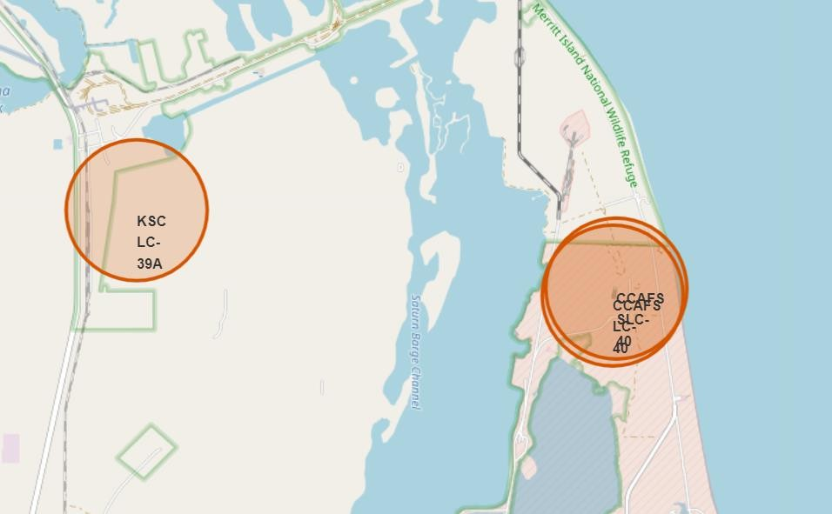
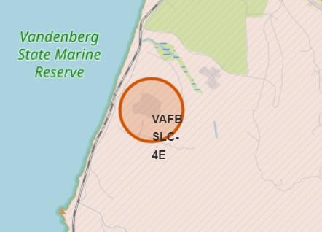
SpaceX Falcon9 - Launch Sites Map
Figure 1 on left displays the Global map with Falcon 9 launch sites that
are located in the United States (in California and Florida). Each launch site contains a circle, label, and a popup to highlight the location and the name of the launch site. It is also evident that all launch sites are near the coast.
Figure 2 and Figure 3 zoom in to the launch sites to display 4 launch sites:
VAFB SLC-4E (CA)
CCAFS LC-40 (FL)
KSC LC-39A (FL)
CCAFS SLC-40 (FL)
Fig 1 – Global Map
36
Fig 2 – Zoom 1
Fig 3 – Zoom 2

Slide 37
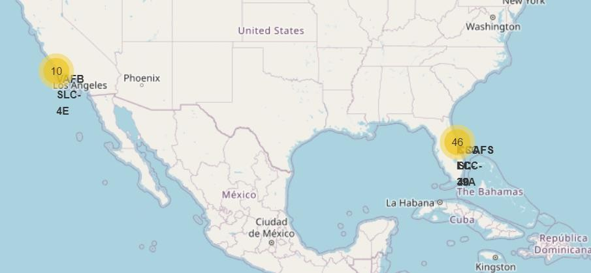
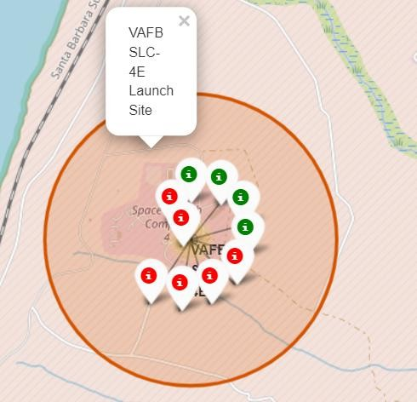
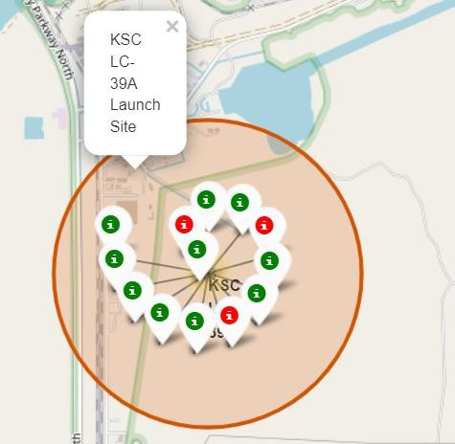
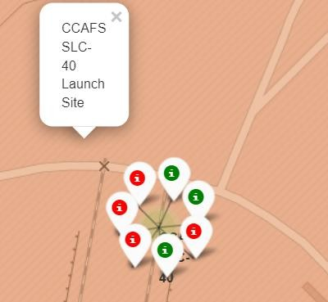
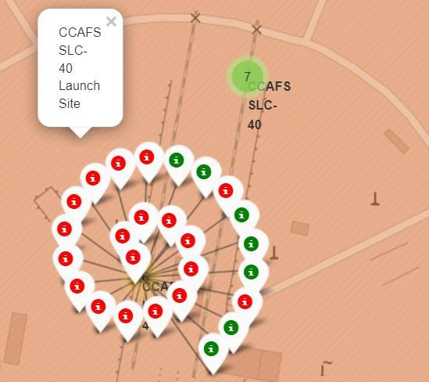
SpaceX Falon9 – Success/Failed Launch Map for all Launch Sites
Figure 1 is the US map with all the Launch Sites. The numbers on each site depict
the total number of successful and failed launches
Figure 2, 3, 4, and 5 zoom in to each site and displays the success/fail markers with green as success and red as failed
By looking at each site map, KSC LC-39A Launch Site has the greatest number of successful launches
Fig 1 – US map with all Launch Sites
37
Fig 2 – VAFB Launch Site with success/failed markers
Fig 3 – KSC LC-39A
success/failed markers
Fig 4 – CCAFS SLC-40
success/failed markers
Fig 5 – CCAFS SLC-40
success/failed markers

Slide 38
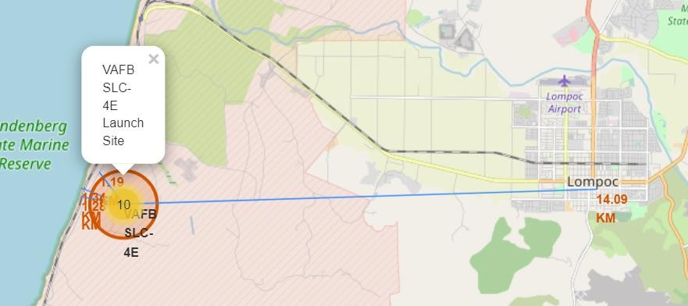
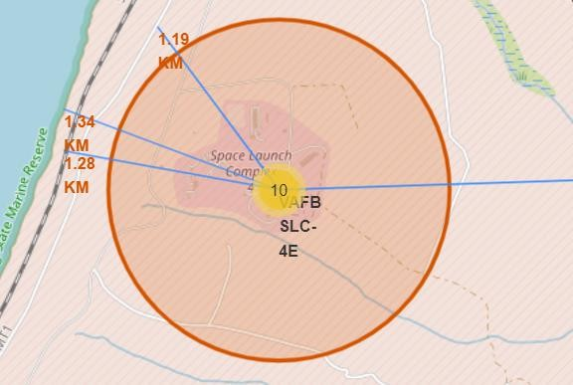
SpaceX Falcon9 – Launch Site to proximity Distance Map
Figure 1 displays all the proximity sites marked on the map for Launch Site VAFB SLC-4E. City Lompoc is located further away from Launch Site compared to other proximities such as coastline, railroad, highway, etc. The map also displays a marker with city distance from the Launch Site (14.09 km)
Figure 2 provides a zoom in view into other proximities such as coastline, railroad, and highway with respective distances from the Launch Site
In general, cities are located away from the Launch Sites to minimize impacts of any accidental impacts to the general public and infrastructure. Launch Sites are strategically located near the coastline, railroad, and highways to provide easy access to resources.
Fig 1 – Proximity site map for VAFB SLC-4E
38
Fig 2 – Zoom in for sites – coastline, railroad, and highway

Slide 39


Slide 40
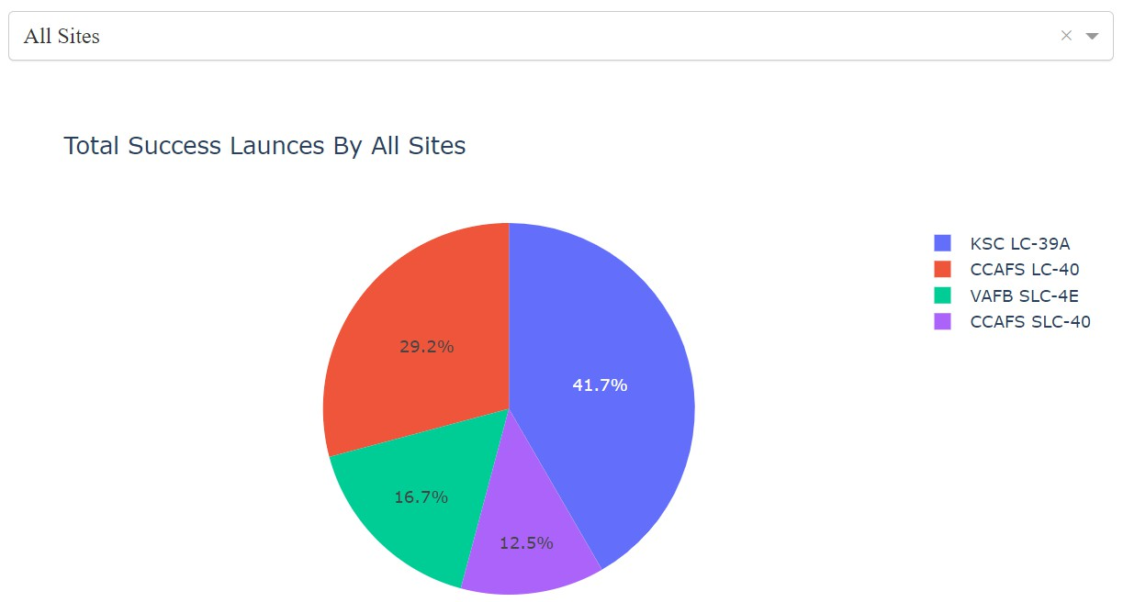
Launch Success Counts For All Sites
Launch Site ‘KSC LC-39A’ has the highest launch success rate
Launch Site ‘CCAFS SLC- 40’ has the lowest launch success rate

Slide 41
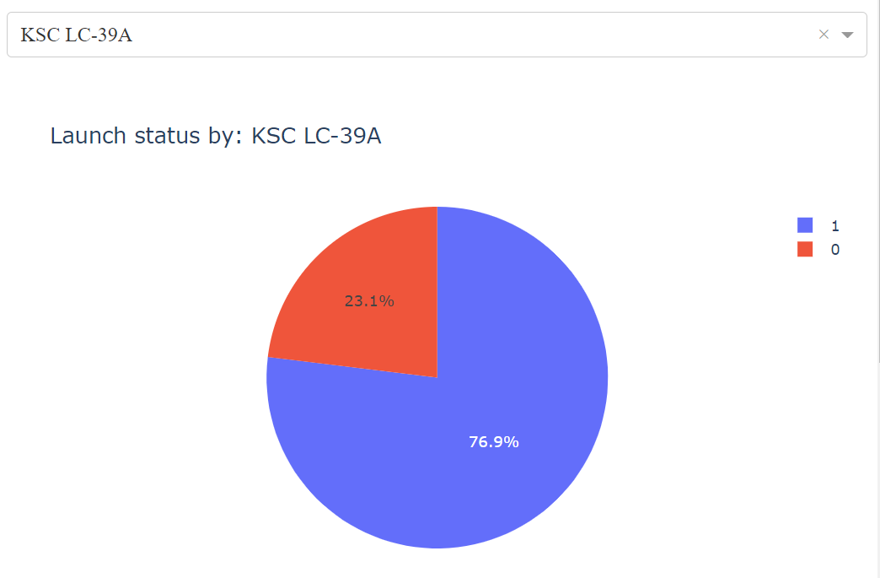
Launch Site with Highest Launch Success Ratio
KSC LC-39A Launch Site has the highest launch success rate and count
Launch success rate is
76.9%
Launch success failure
rate is 23.1%

Slide 42
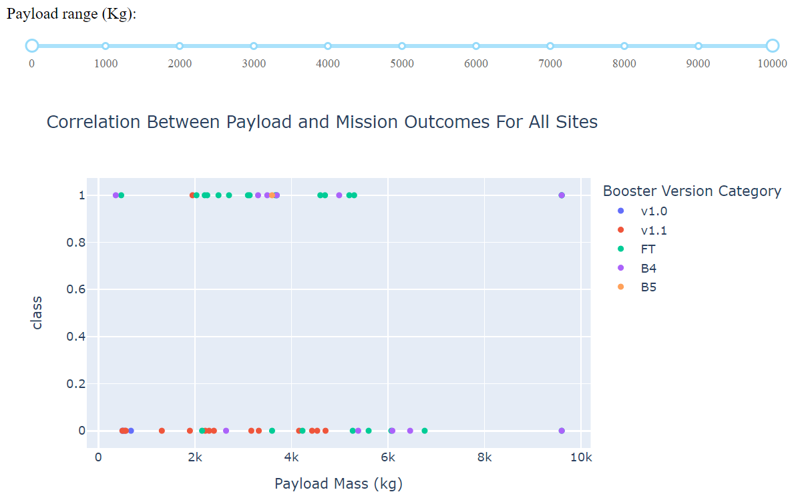
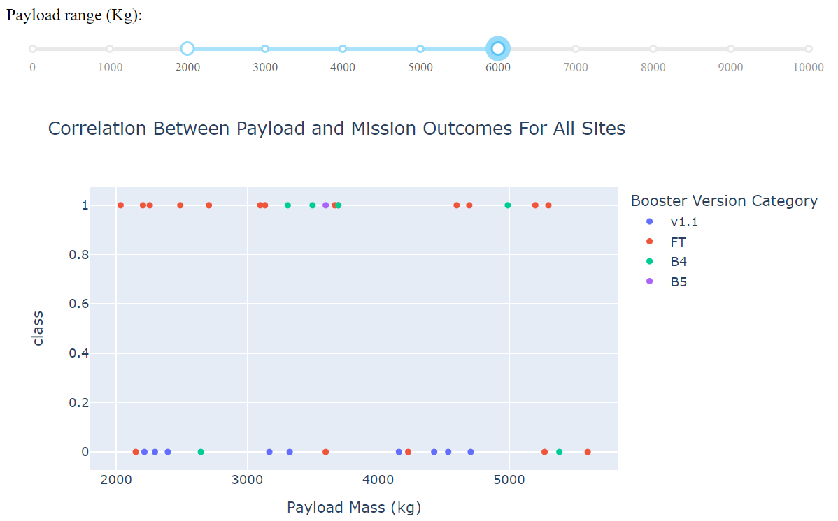
Payload vs. Launch Outcome Scatter Plot for All Sites
Most successful launches are in the payload range from 2000 to about 5500
Booster version category ‘FT’ has the most successful launches
Only booster with a success launch when payload is greater than 6k is ‘B4’
42

Slide 43


Slide 44
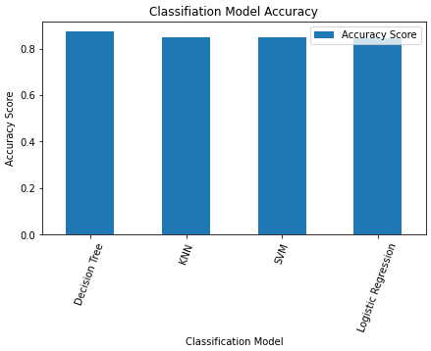
Classification Accuracy
Based on the Accuracy scores and as also evident from the bar chart, Decision Tree algorithm has the highest classification score with a value of .8750
Accuracy Score on the test data is the same for all the classification algorithms based on the data set with a value of .8333
Given that the Accuracy scores for Classfication algorithms are very close and the test scores are the same, we may need a broader data set to further tune the models

Slide 45
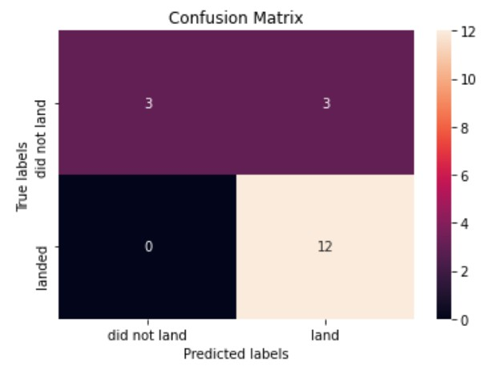
Confusion Matrix
The confusion matrix is same for all the models (LR, SVM, Decision Tree, KNN)
Per the confusion matrix, the classifier made 18 predictions
12 scenarios were predicted Yes for landing,
and they did land successfully (True positive)
3 scenarios (top left) were predicted No for landing, and they did not land (True negative)
3 scenarios (top right) were predicted Yes for landing, but they did not land successfully (False positive)
Overall, the classifier is correct about 83% of the time ((TP + TN) / Total) with a misclassification or error rate ((FP + FN) / Total) of about 16.5%

Slide 46
Conclusions
As the numbers of flights increase, the first stage is more likely to land successfully
Success rates appear go up as Payload increases but there is no clear correlation between Payload mass and success rates
Launch success rate increased by about 80% from 2013 to 2020
Launch Site ‘KSC LC-39A’ has the highest launch success rate and Launch Site ‘CCAFS SLC- 40’ has the lowest launch success rate
Orbits ES-L1, GEO, HEO, and SSO have the highest launch success rates and orbit GTO the lowest
Lunch sites are located strategically away from the cities and closer to coastline, railroads,
and highways
The best performing Machine Learning Classfication Model is the Decision Tree with an accuracy of about 87.5%. When the models were scored on the test data, the accuracy score was about 83% for all models. More data may be needed to further tune the models and find a potential better fit.
46

Slide 47
Appendix
Include any relevant assets like Python code snippets, SQL queries, charts, Notebook outputs, or data sets that you may have created during this project
47

Slide 48


